Slide 1
Interpreting shot gathers via Vista - GOPH 557 Lab2
Danel Trad
Mathew Vernon
Safian Qureshi
ID: 10086638

Slide 2
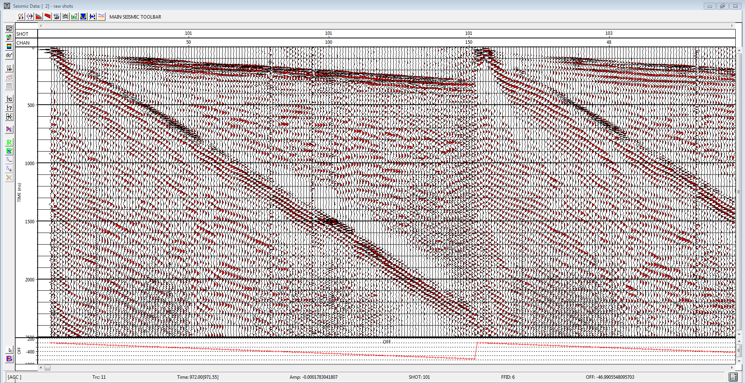
lab1part1.PNG
A)1174m, 1250.3m
Notes:
Lab 1 Part 1 Question 9
How many shots are there? 588
How many traces in total? 73904
What is the number of channels per shot? 172
What is the time sampling rate? 4000

Slide 3
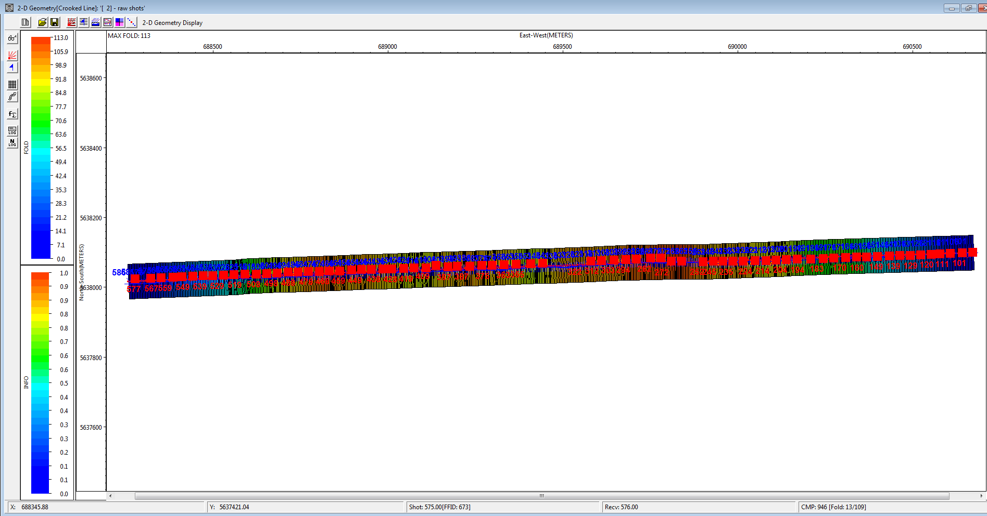
lab1part2.PNG
Notes:
Lab 1 Part 2 Question 8
i) What are the minimum and maximum shot and receiver elevations? 1174m, 1250.3m
ii) What are the group and shot intervals? 10

Slide 4
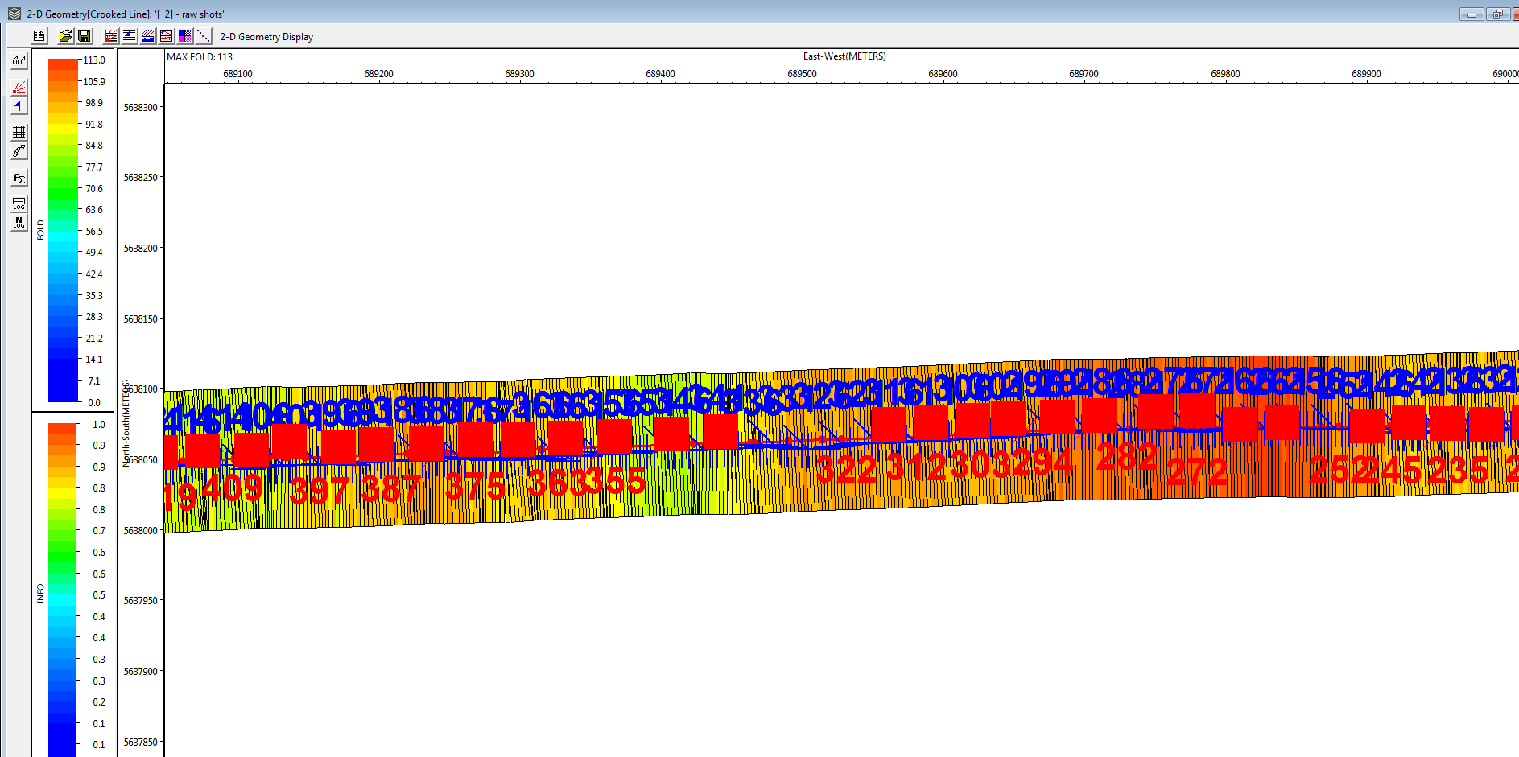
lab1part2question4.PNG zoomed
Notes:
Lab 1 Part 2 Question 8
iv) Plot your surface display of the line geometry and indicate an area with missing shots.
There are missing shots roughly between the 689450m – 689550m location on the east-west line

Slide 5
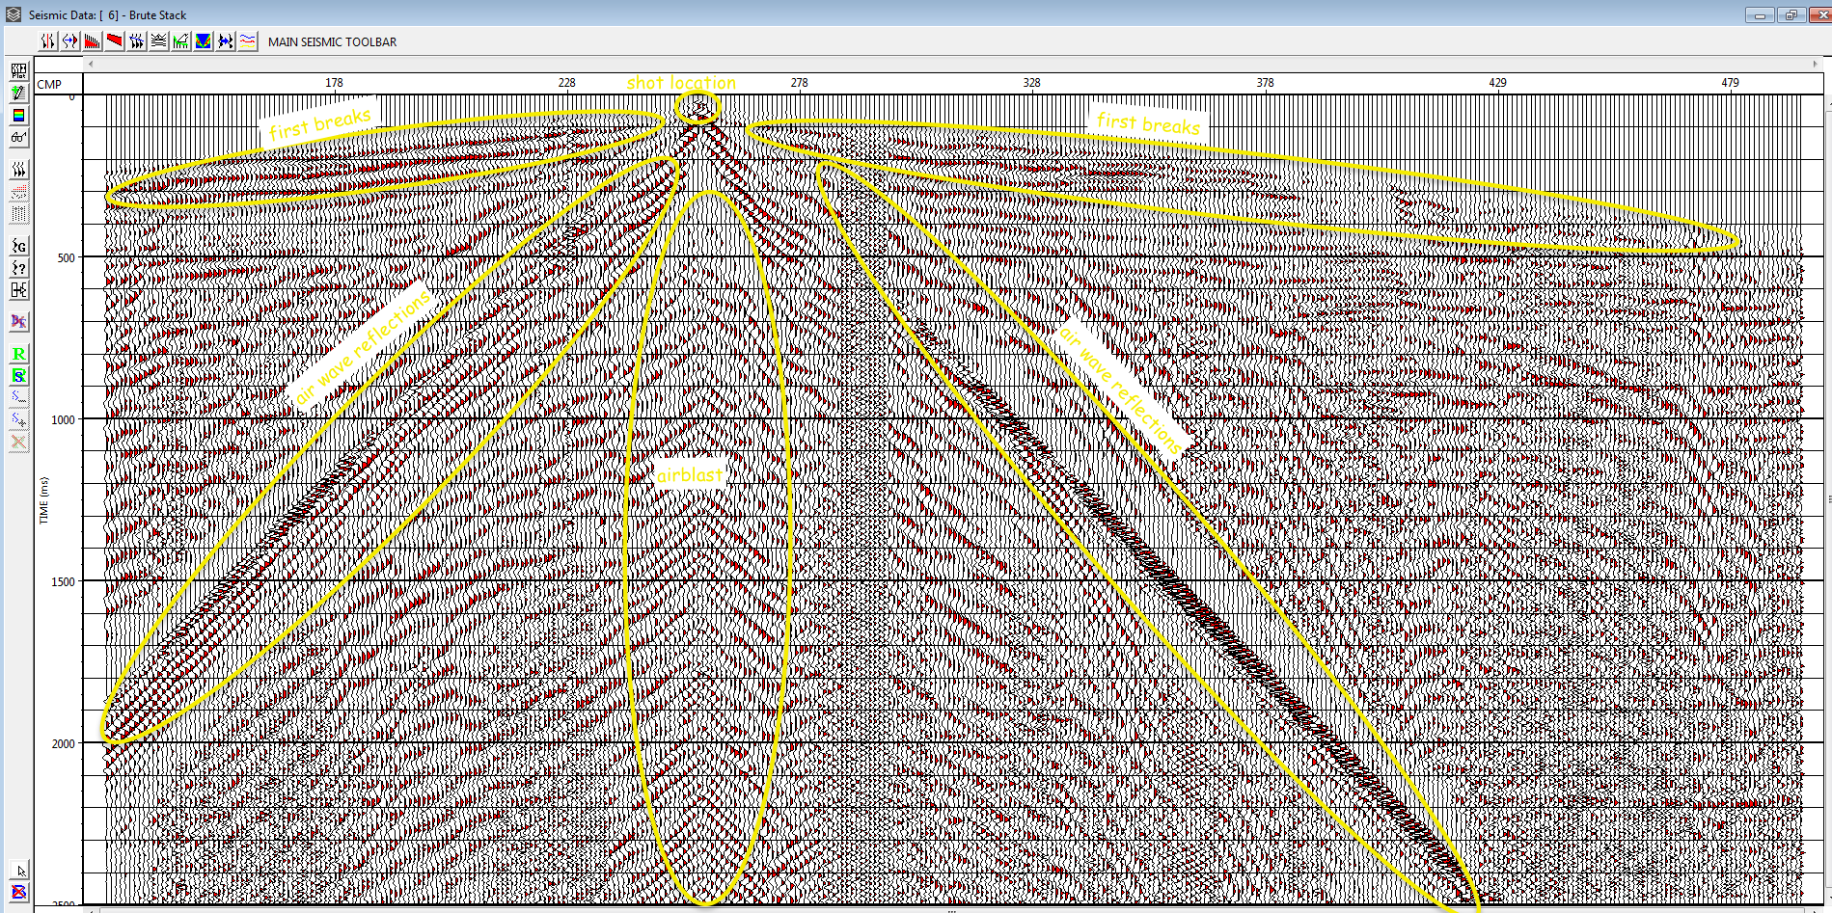
lab1part4question1.PNG

Slide 6
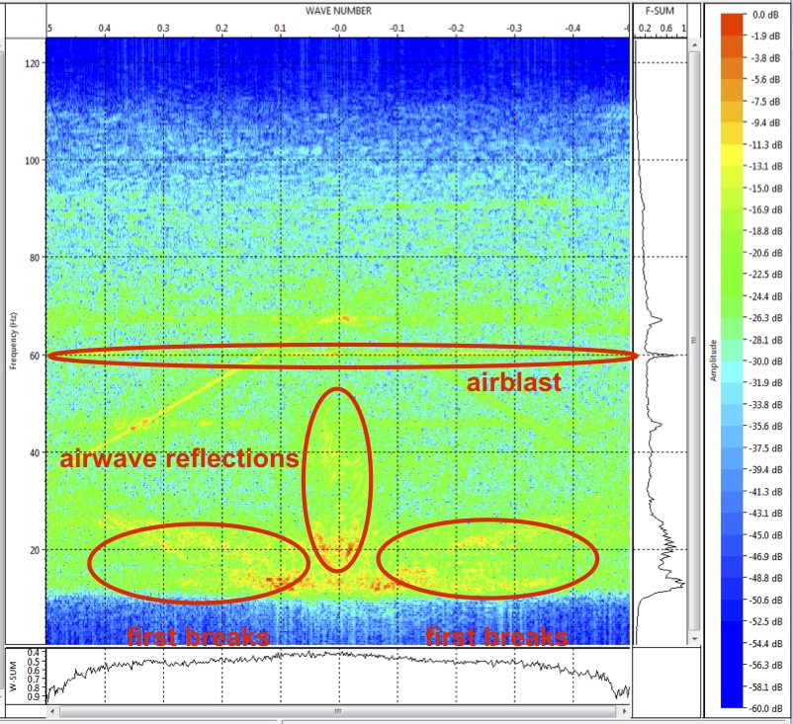
lab1part4question2.PNG

Slide 7
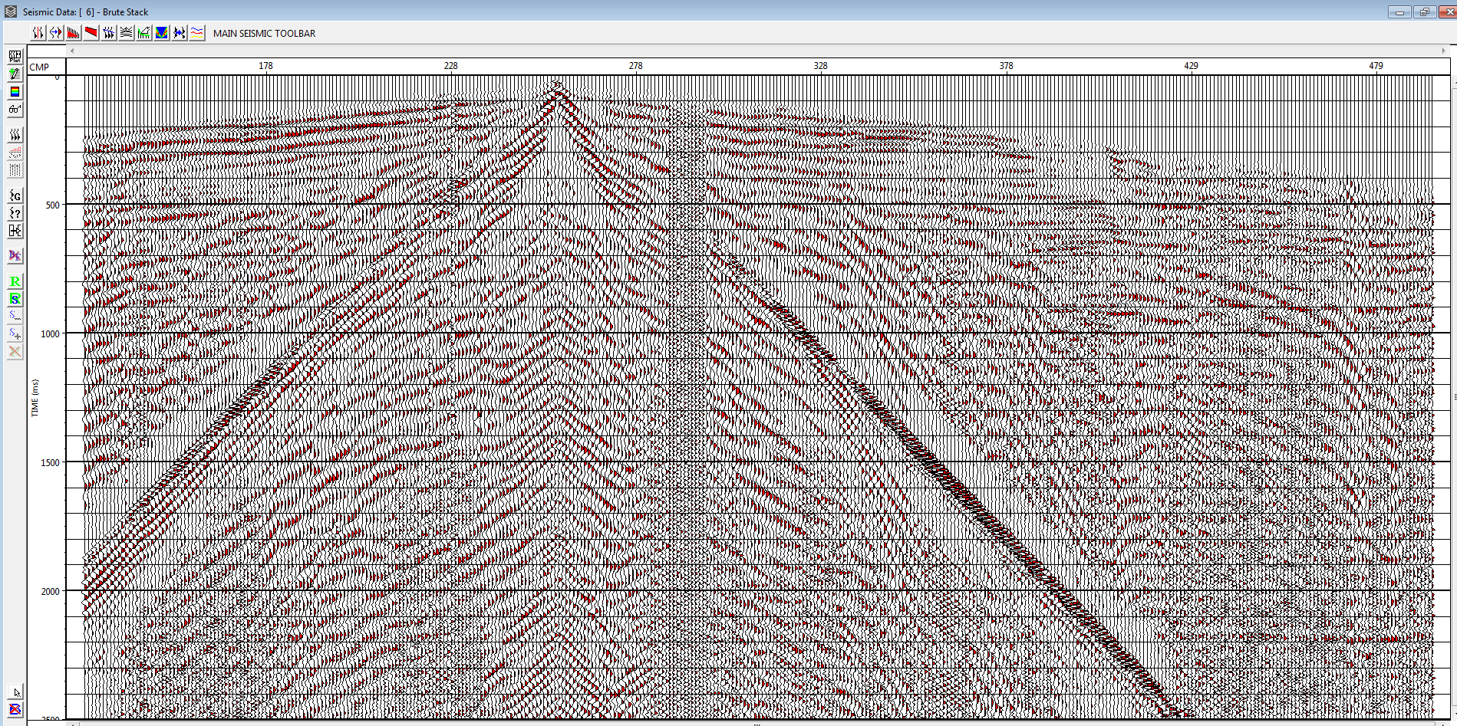
lab2part1question3.PNG Using AGC Gain on shot 228
Notes:
Lab 2 Question 1
Using AGC gain produced a better shot record compared to exponential shot records which emphasized the airwave reflections too much

Slide 8
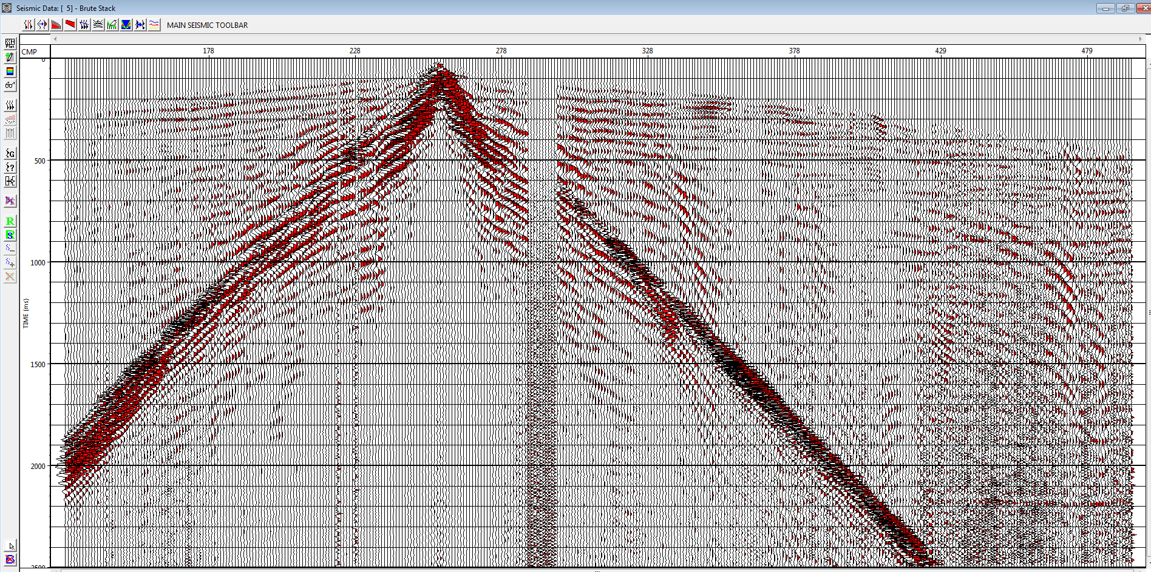
lab2part1question4.PNG Using exponential time gain
Notes:
Using exponential time gain enhanced the airwave reflections too much which is counterintuitive and not preferable

Slide 9
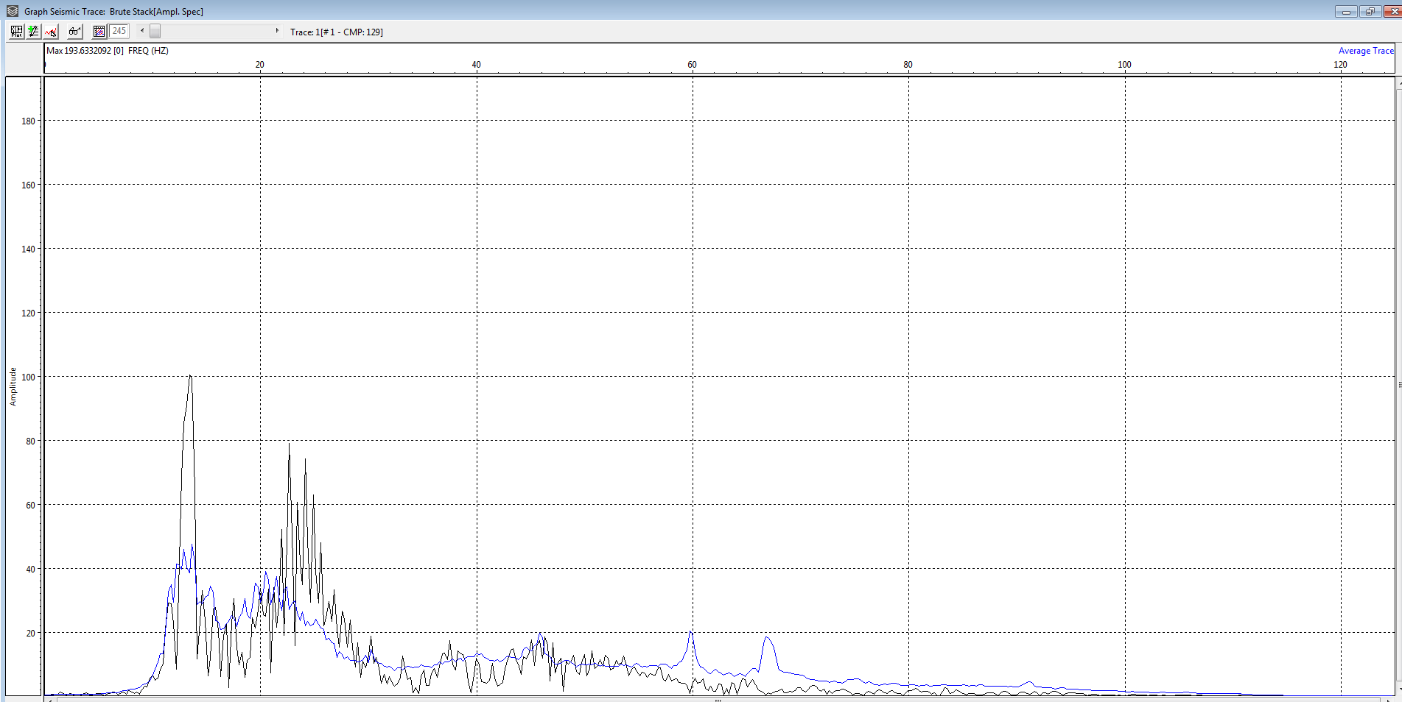
lab2part2question1.PNG Amplitude spectrum shot 228

Slide 10
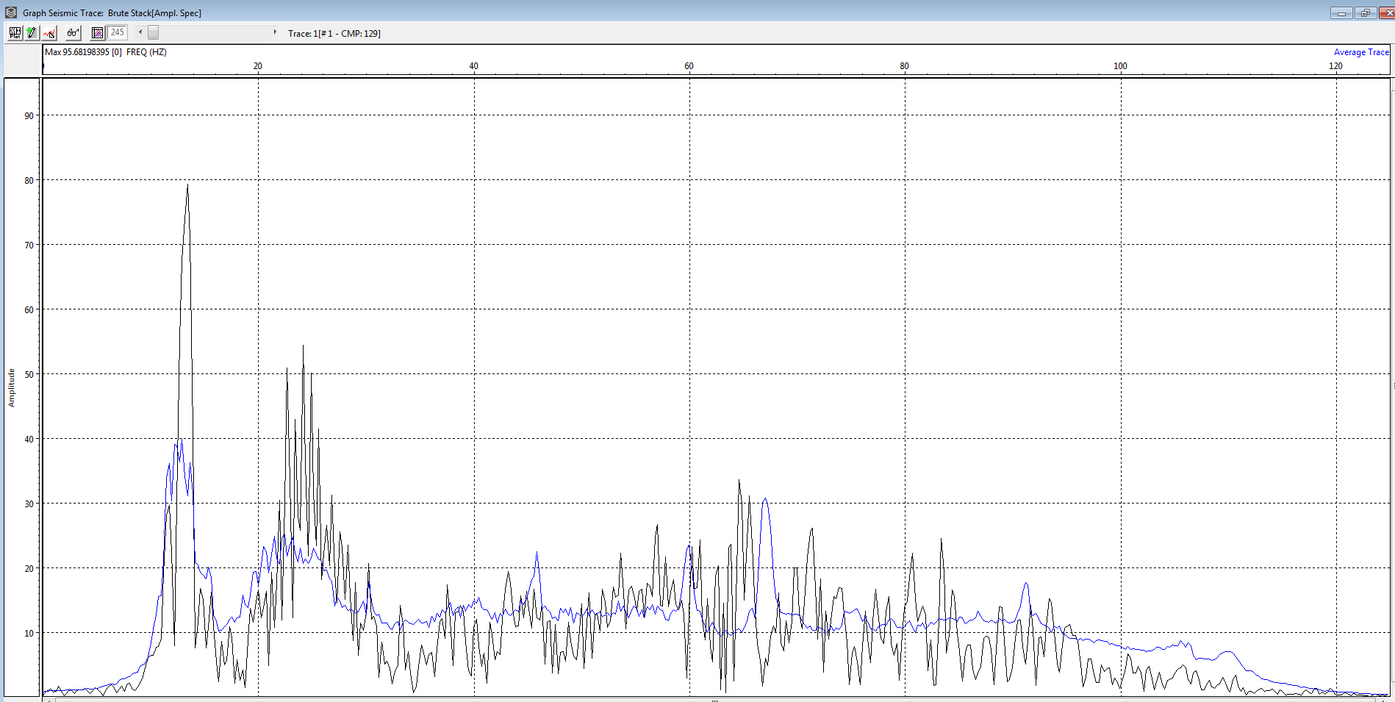
lab2part2question2.PNG deconvolved shot amplitude spectrum
Notes:
Lab 2 Question 2d
Noticing the vertical axis, the magnitude has gotten smaller

Slide 11
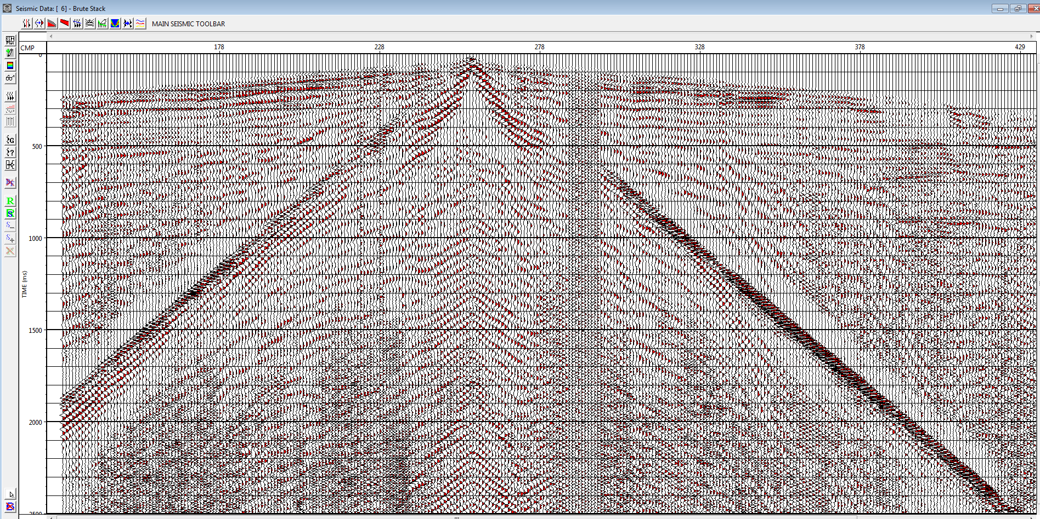
lab2part2question3.PNG deconvolved shot 228
Notes:
Lab 2 Question 2e
Parameter used 10ms length for decon

Slide 12
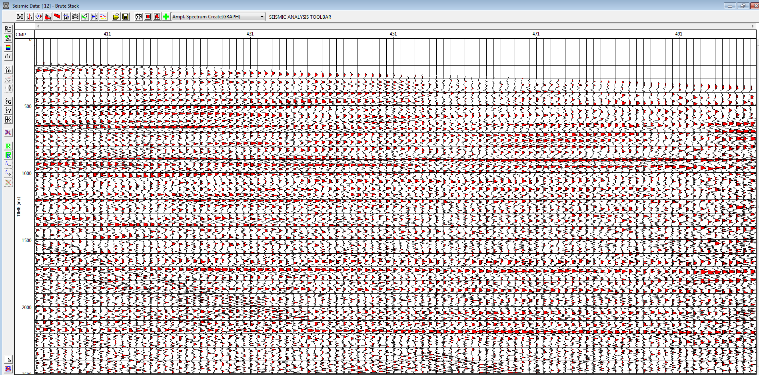
lab2part3question1.PNG
Notes:
Lab 2 question 3

Slide 13
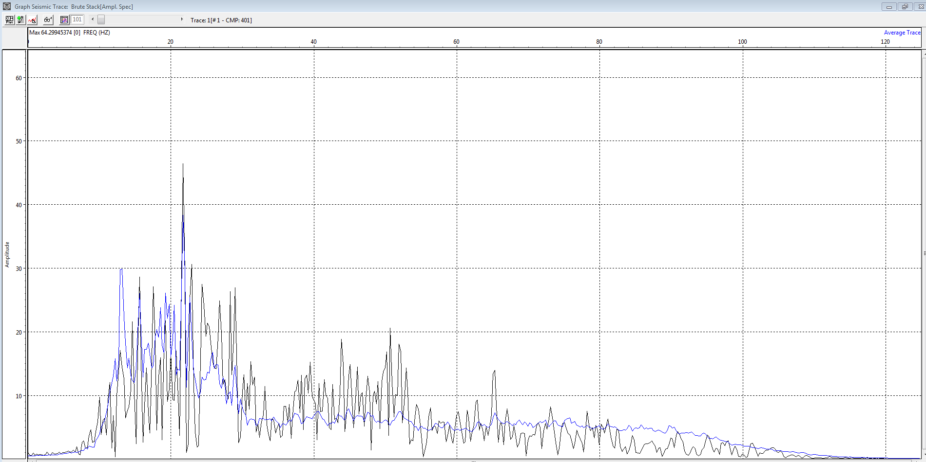
lab2part3question2.PNG
Notes:
Lab 2 question 3

Slide 14
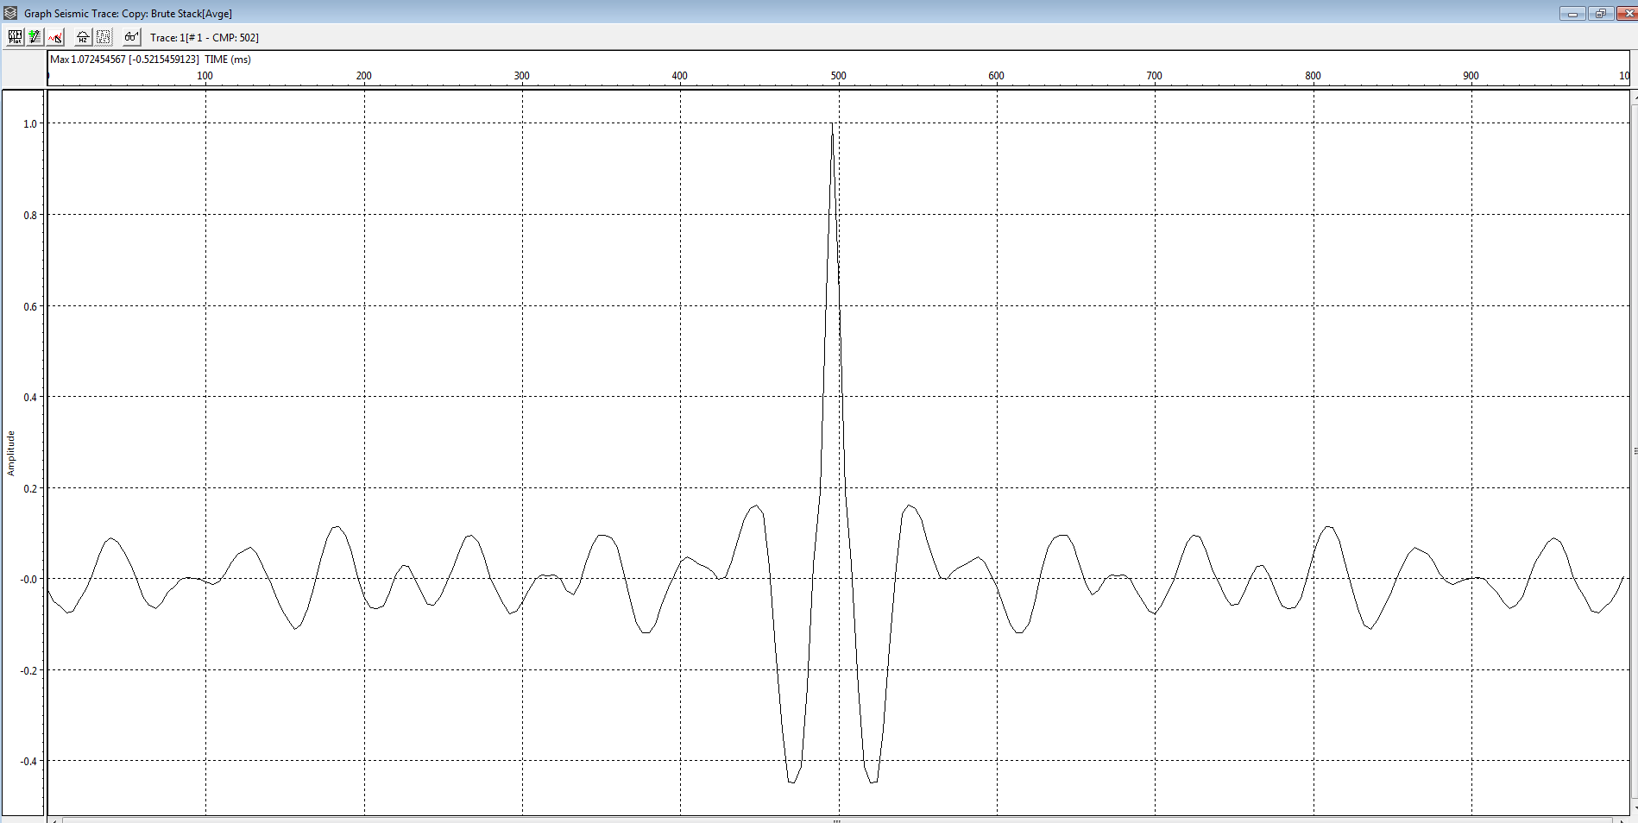
lab2part4question1.PNG autocorrelation
Notes:
Lab 2 Question 4
Autocorrelation is when signal is compared with itself for multiple time shifts. Useful for detecting repeating periods within signals. The autocorrelation function is normalized so that maximum value at zero lag is 1 which is shown in the figure above.

Slide 15
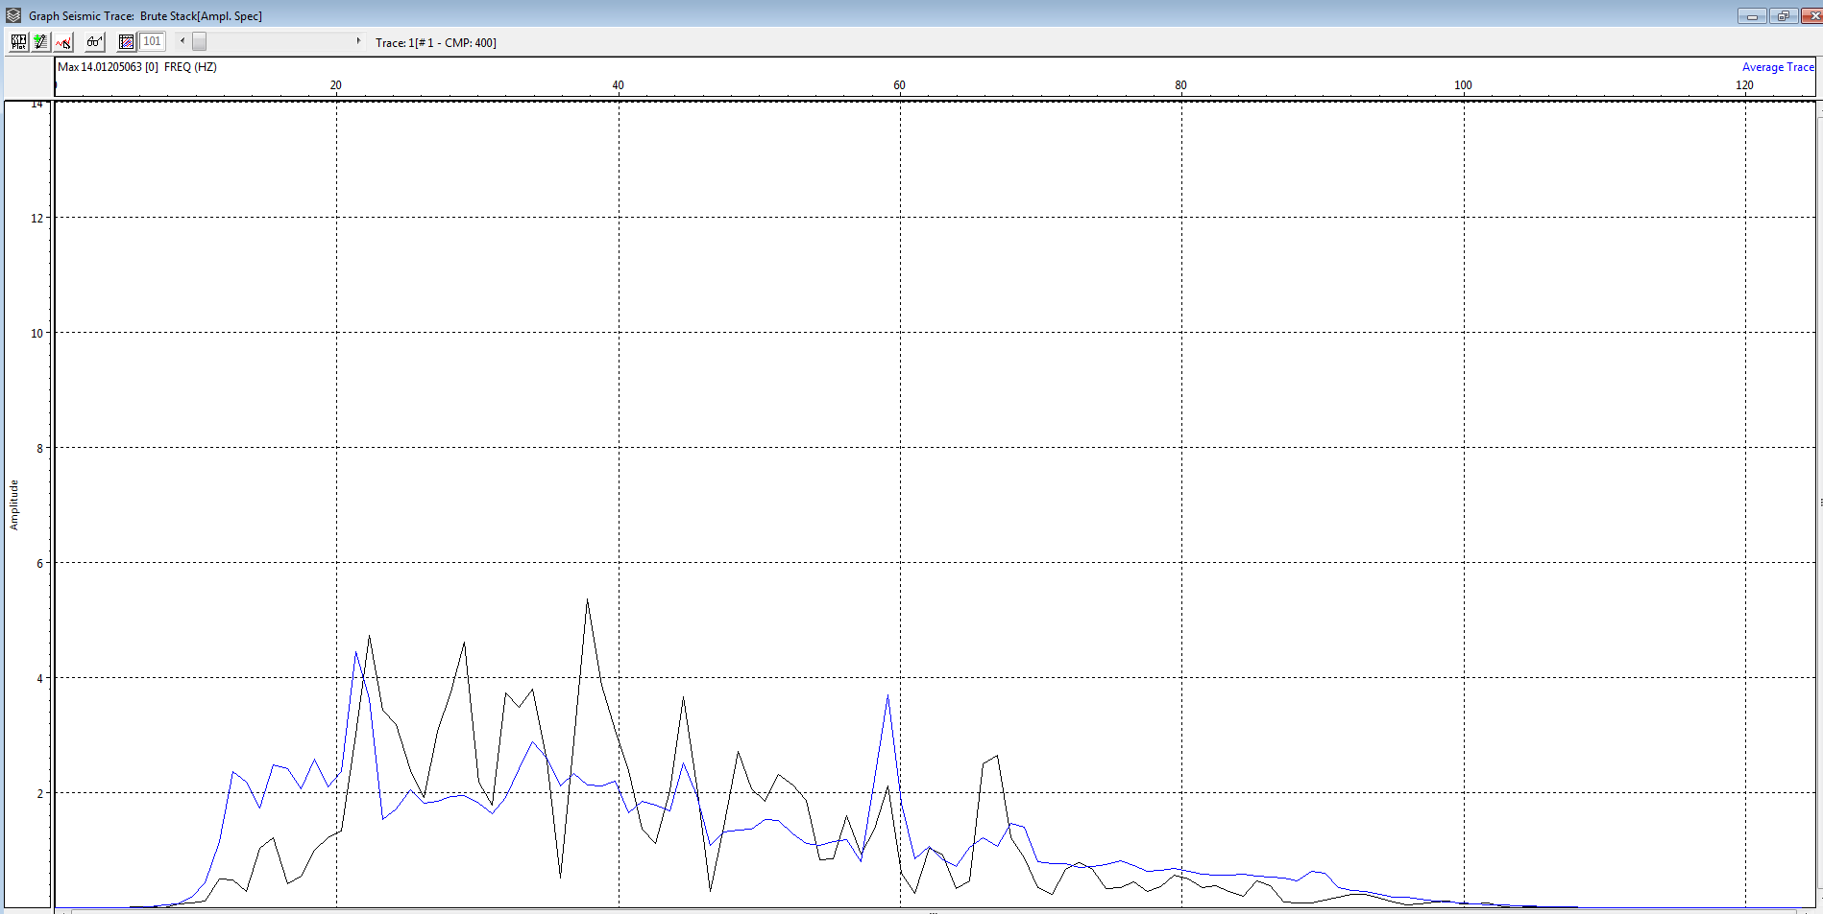
lab2part5length10amplitude.PNG testing different decon lengths

Slide 16
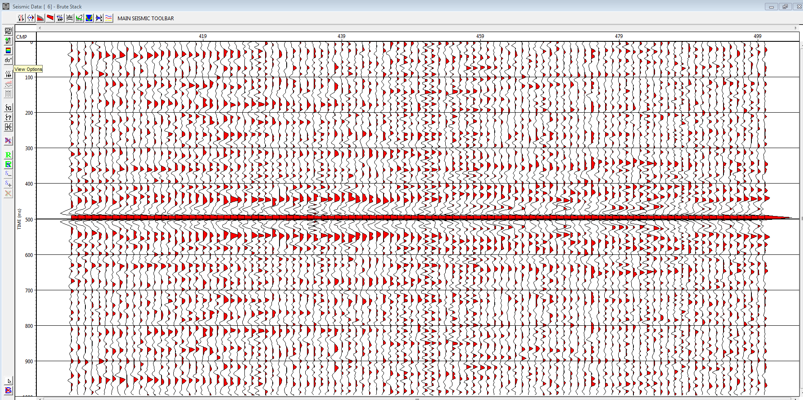
lab2part5length10data.PNG

Slide 17

lab2part5length20amplitude.PNG

Slide 18
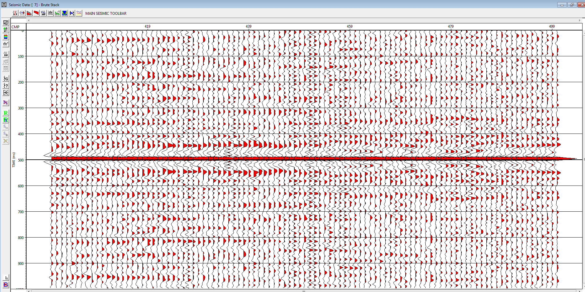
lab2part5length20data.PNG

Slide 19

lab2part5length100amplitude.PNG

Slide 20
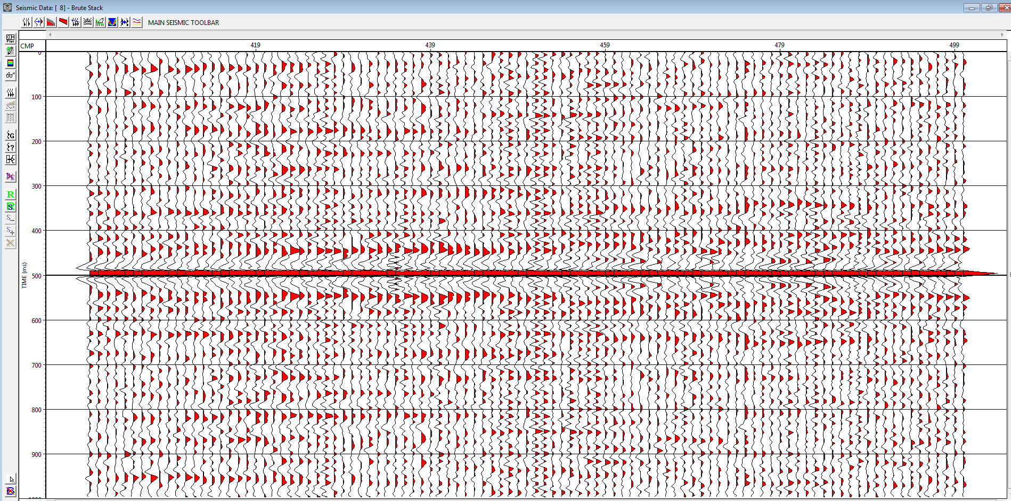
lab2part5length100data.PNG
Notes:
Lab 2 Question 5 e and f
e) Optimal decon length for me still remained 10ms
f) Stacking works by effecting the average, averaging it out

Slide 21
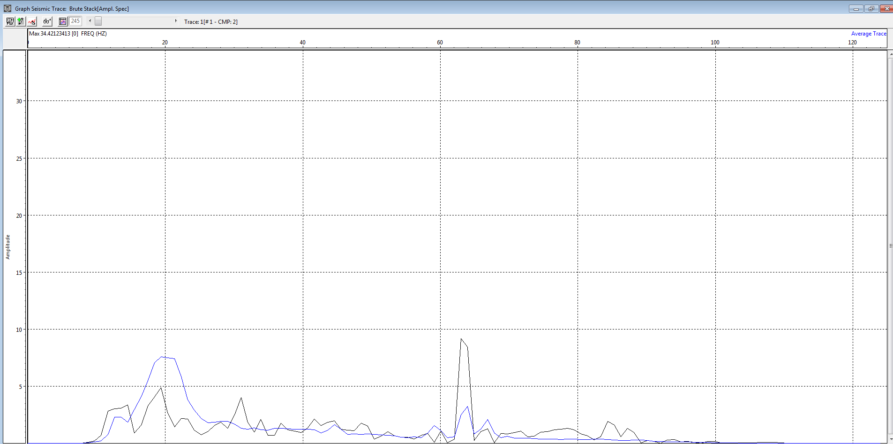
lab2part6.PNG
All CMP gathers
Notes:
Lab 2 Question 7
Questions: a) What is the purpose of each step in your brute stack flow? b) What is the average frequency spectrum band after stack? (Usable frequencies are greater
than 20 db down.) Explain why the spectrum is not totally white after stacking.
c) Explain why you chose the decon parameters you used in (6)
a) the input takes the specified data in. in our case, a single shot. Applying gain to it helps with the traces troughs and peaks, helping one interpret events better. The NMO step compensates compensates for the effects of the separation between seismic sources and receivers in the case of a horizontal reflector. Lastly the output function at the end uses certain parameters to produce the resulting shot record
b) 2hz
c) The reason why the length 10 parameter worked best for me it seemed to have the best effect on the trace wavelets in the shot gather. The other lengths made the trace wavelets magnitudes too big

Slide 22
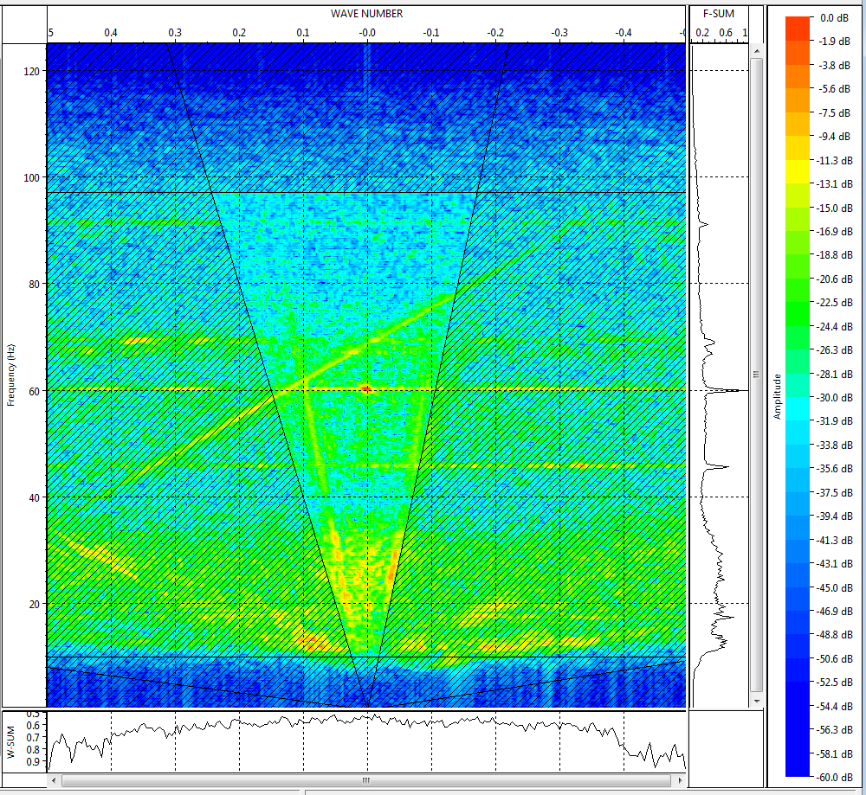
Lab3part1q5.PNG FK filter plot

Slide 23
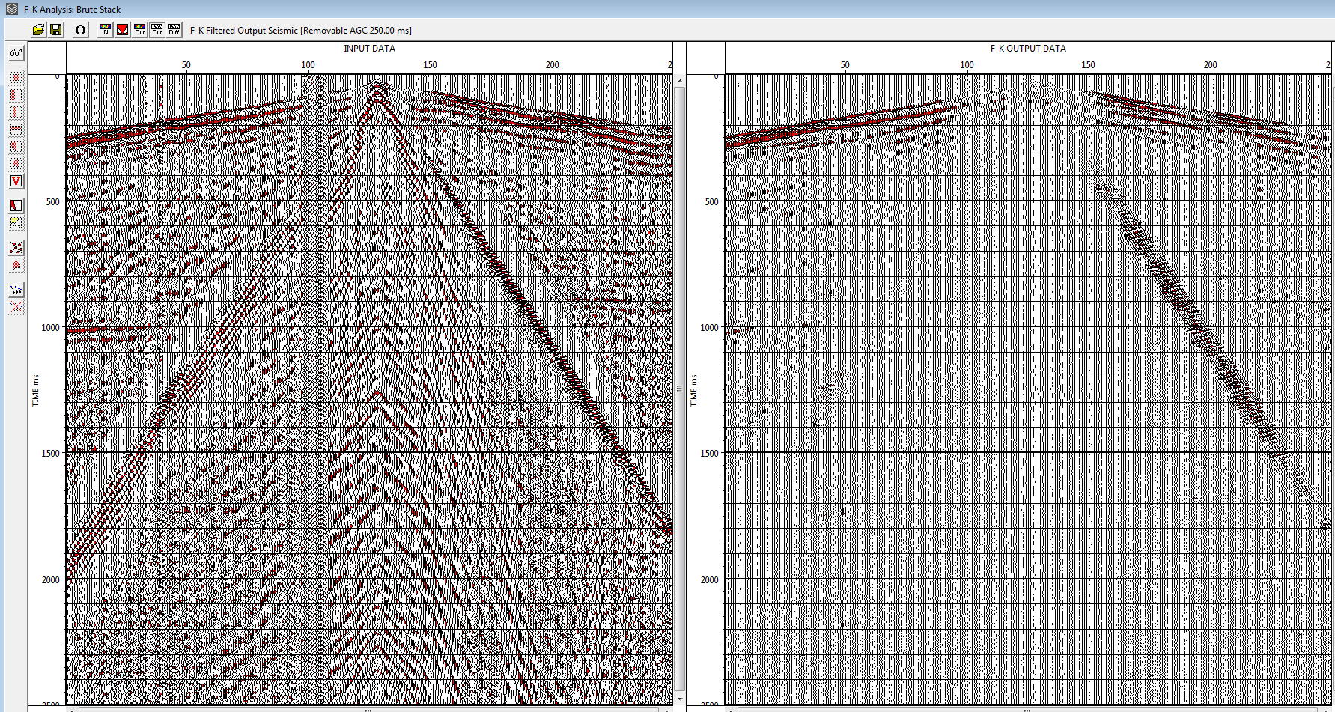
lab3part1q2.PNG
Notes:
Unfiltered vs filtered shot 228

Slide 24
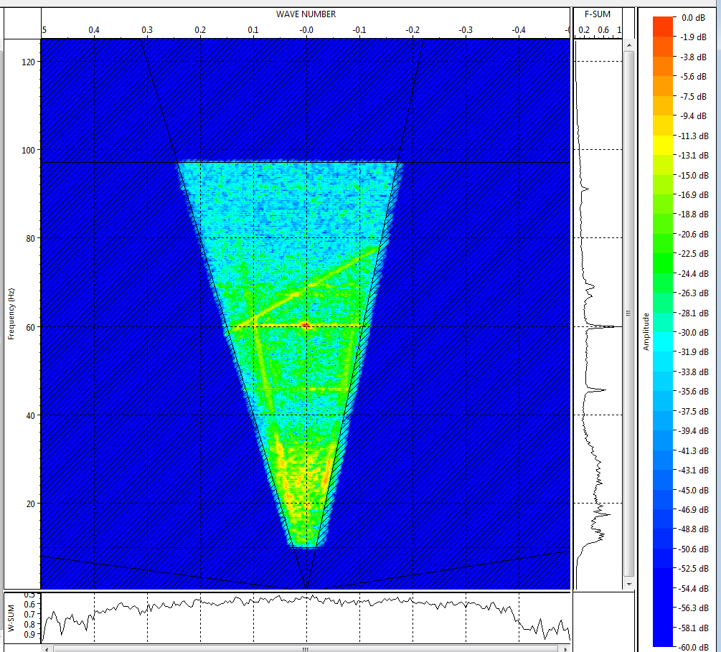
lab3part1q3.PNG filtered FK plot

Slide 25
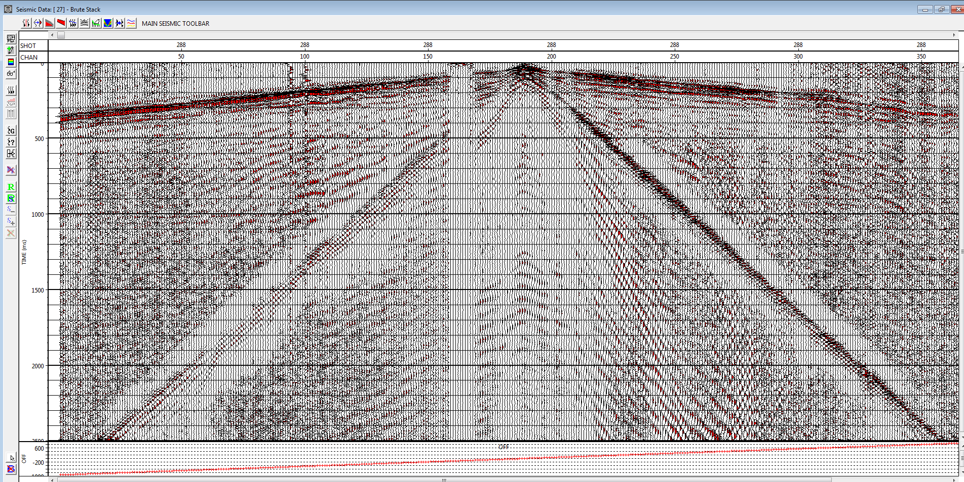
lab3part2.PNG
Notes:
Applying FK filter previously created and then applying deconvolution algorithm

Slide 26
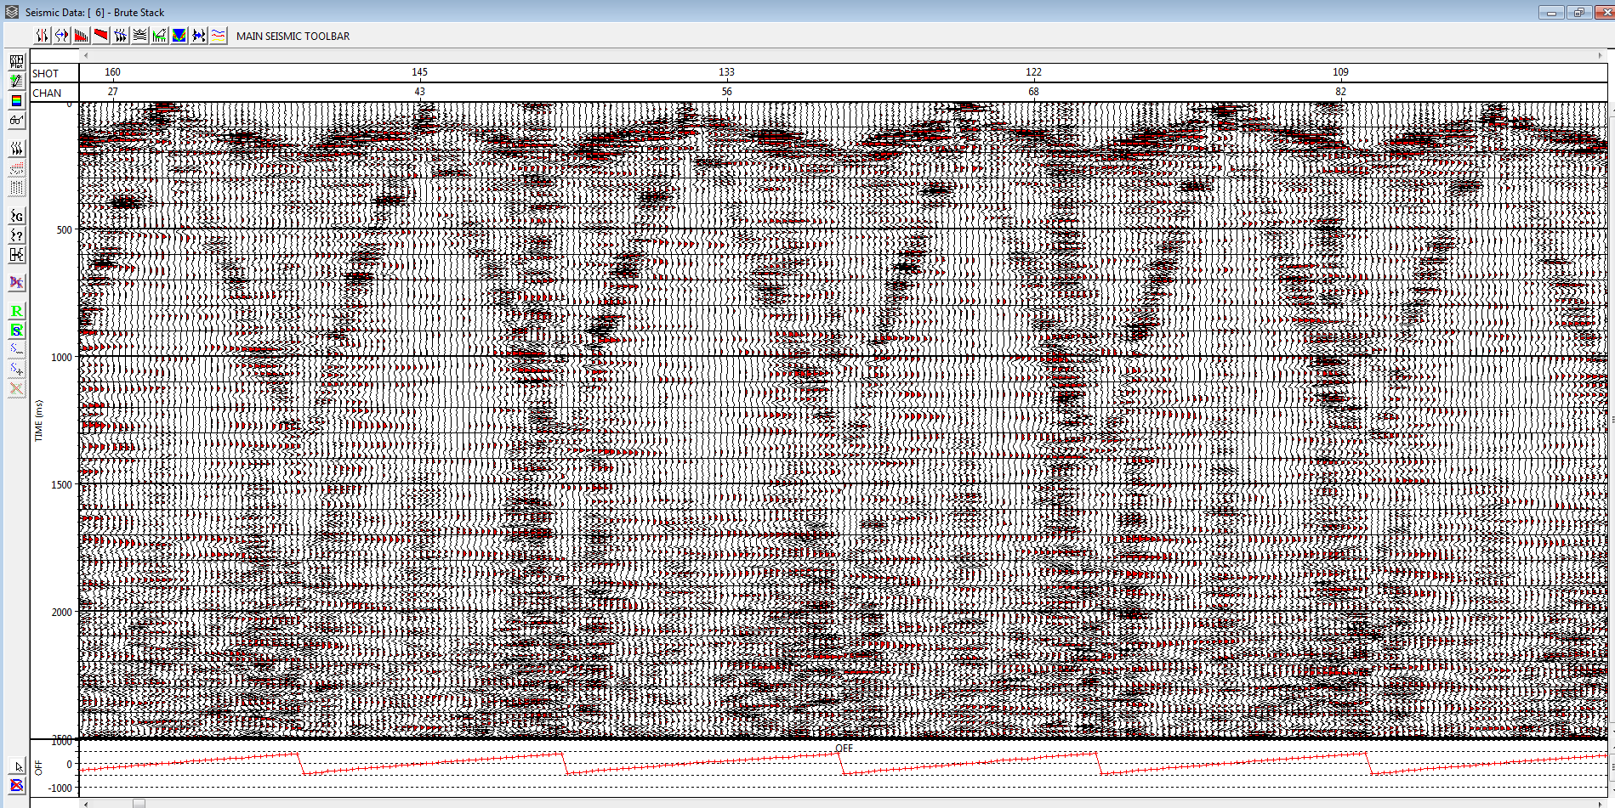
lab3part3.PNG deconvolved shot gather with filter applied
Notes:
Questions:
a) Explain what the F-K filter does to the input data.
b) Describe and explain the main differences you see on the F-K stack compared with your
previous stack.
c) Why should this filter be applied to the input data? Why is it not necessary to remove the
first breaks?
d) How successful are you in removing noise in the shot gather? What are the difficulties
encountered in removing the air blast? Explain its location within the F-K spectrum.
a) The FK filter attempts to remove the airwave reflections groundroll and airblast from our shot 288
b) In the filtered stack, we can see that there is quite a big removal of noise and the left airwave reflection is gone along with airblast/groundroll. We are left with the first breaks relatively unchanged which is of interest
c) The reason why this should be applied is so that we can clearly see the first breaks and remove ’events’ of noninterest such as the blast/airwave reflections. Removal of first breaks isnt necessary as it may help guide for deeper events
d) Relatively successful in removing noise and events of non interest. The difficulty I had was trying to remove the right side airwave reflection. I could not seem to remove that with also removing the first breaks and data of interest.

Slide 27
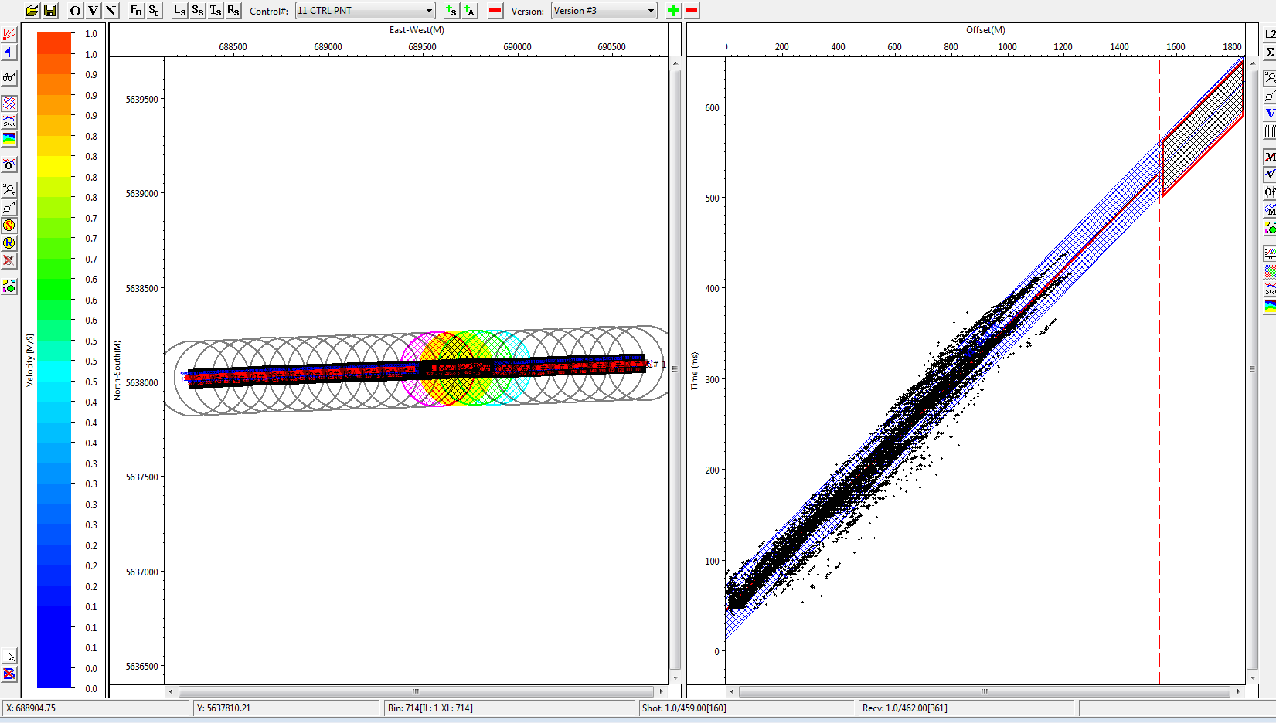
Lab4part2q1.PNG

Slide 28
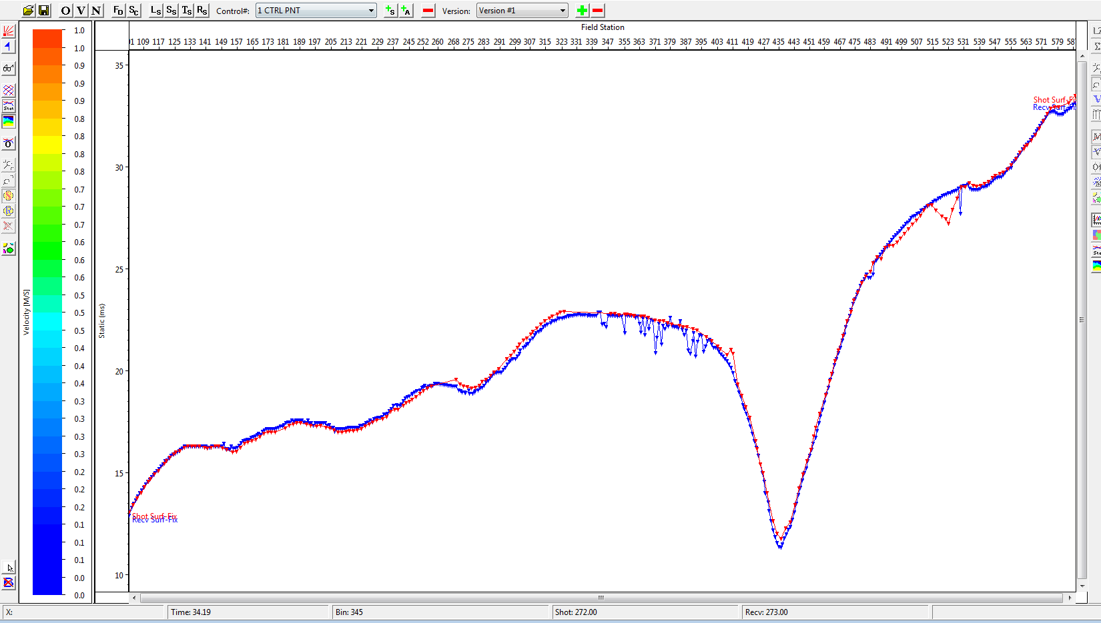
Lab4part2q2.PNG view statics

Slide 29
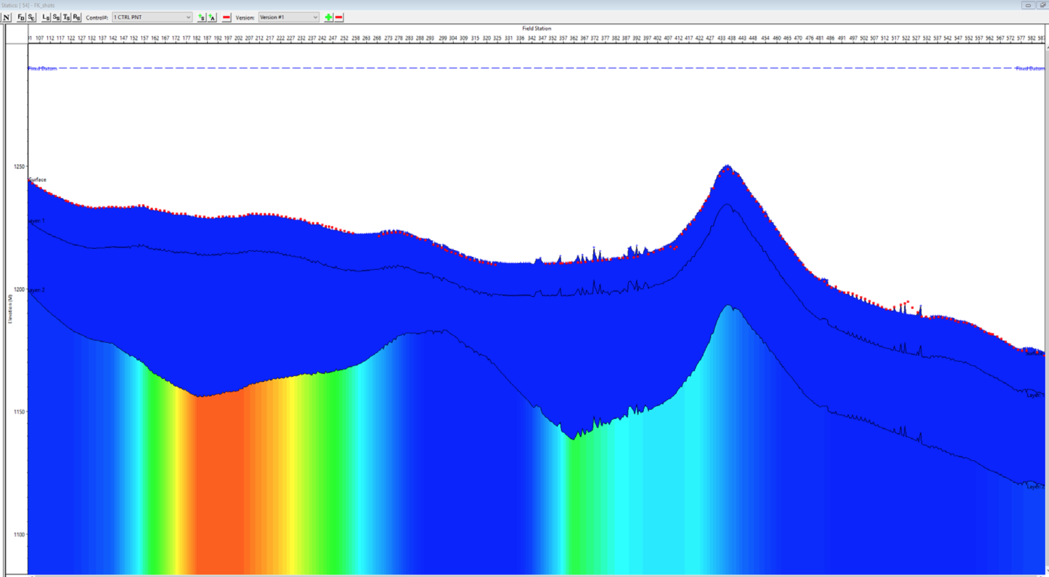
Lab4part2q3.PNG view statics 2

Slide 30
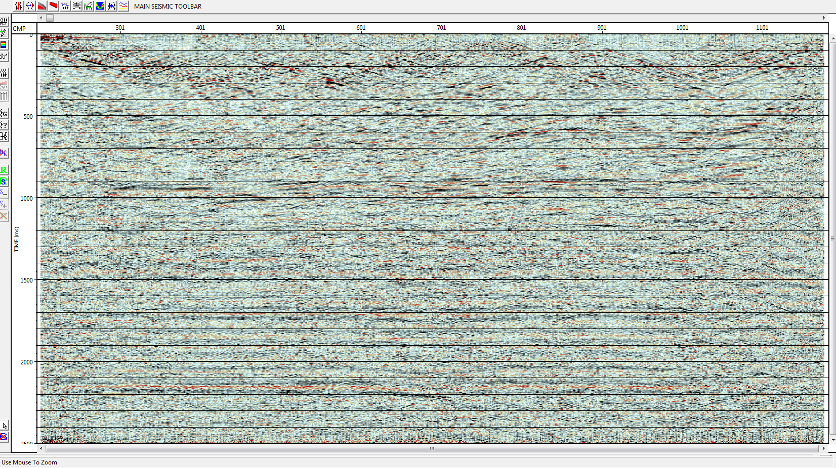
Lab4part3.PNG new stack no statics applied

Slide 31
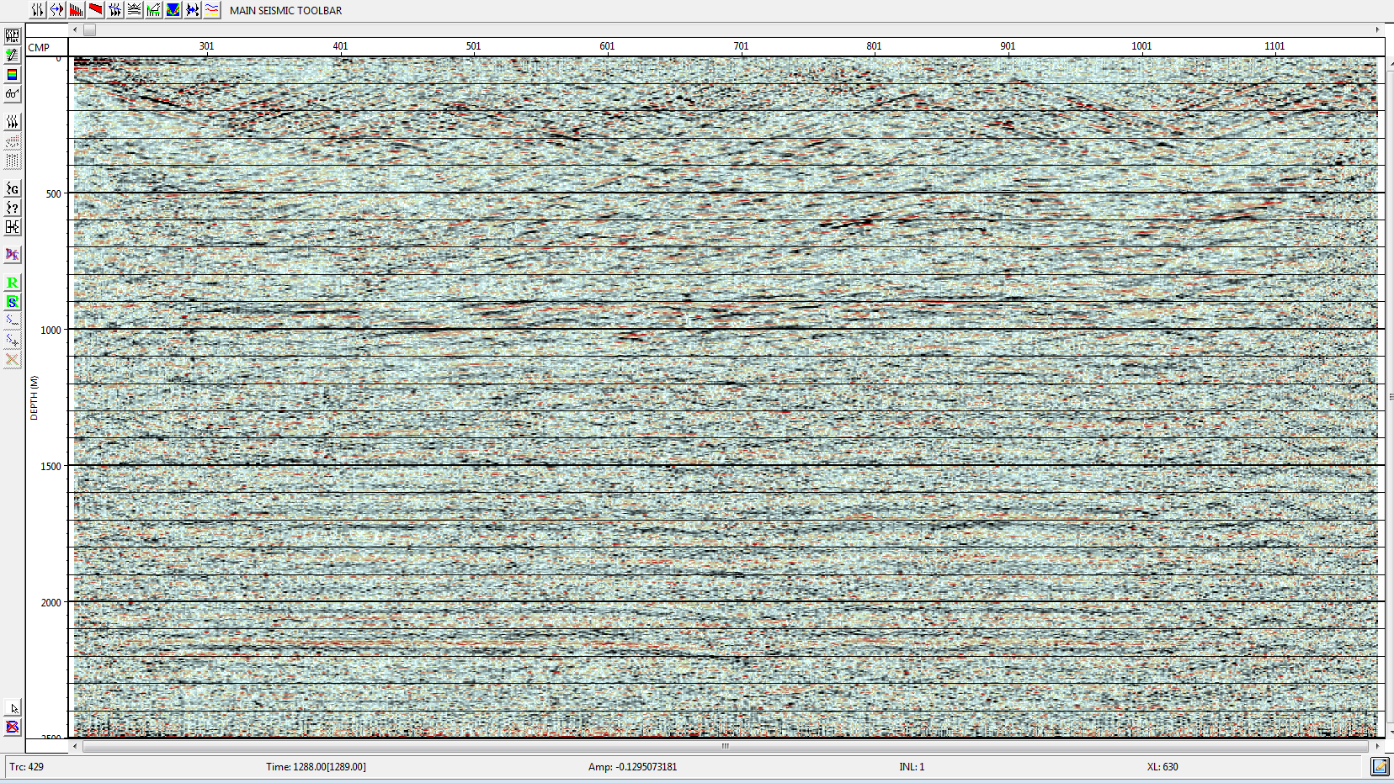
Lab4part4.PNG refraction and elevation

Slide 32
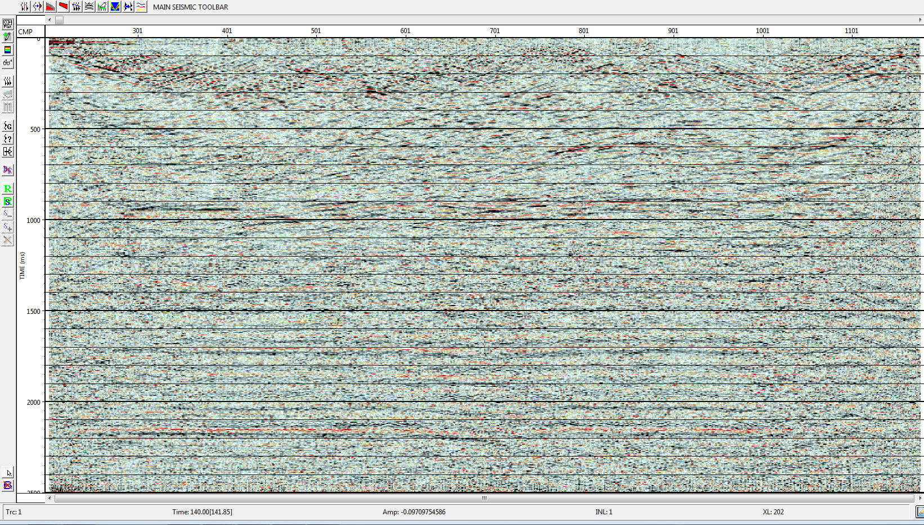
Lab4part4.PNG residual also applied
Notes:
Questions
What is the role of first breaks in computing refraction statics? Use a sketch to help explain this.
Explain what is meant by the weathering and elevation components of the total static from part II?
What is the role of the datum?
Summarize how residual statics works.
What were the relative importance of elevation, weathering and residual statics in your final stack?
The role of first breaks in refraction statics essentially define the curve shape in our view statics graphs. Useful for later on when creating velocity profile as well
Defining weathering and elevation components of total statics is used in conjunction with the datum. By setting and defining specific parameters, these help in generating the curves and statics in our statics shot records later on.
The role of the datum is an average elevation that is defined and uniform along a line
Residual statics work by performing on top of moveout-corrected CMP gathers. Residual statics are done in a surface-consistent manner where the time shifts are dependent only on shot and receiver locations. Residual statics can be thought of as a correction process because the estimated residuals are applied to the original CMP gathers with no NMO correction.
In the final stack we can see that all residual elevation and refraction is applied. The importance of this is we can qualify this stack as the most ‘corrected’ stack out of the previous two.

Slide 33
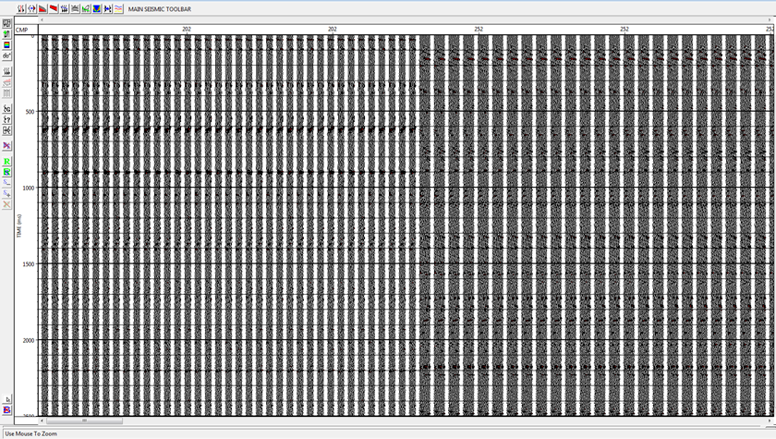
Lab5part1.PNG picking velocities
Notes:
I think I made an error trying to pick velocities so could not generate my profile. I was not able to fully complete the last vista lab but at this point figured I would answer the last labs questions at least
Questions:
1) What is normal moveout?
2) What is a stacking velocity? 3) What information is obtained from the Semblance and CVS during velocity analysis?
4) Did the velocities you picked seem geologically reasonable? Why or why not? 5) Can you distinguish geological features from your migrated section?
What normal move out is essentially the effect that the distance between a seismic source and a receiver (offset distance) has on the arrival time of a reflection in the form of an increase of time with offset.
Stacking velocity is value of seismic velocity obtained from best fit of traveltime curve by hyperbola.
Semblance: maximum amplitude of coherence is expected where a hyperbola best fits a given high amplitude seismic event. Thus, the measure of coherance most often used itself is called semblance. Semblance is prone to being affected by noise, spatial aliasing and lateral variations in amplitude.
CVS: normal moveout is applied and up to ten gathers are and displayed as CVS (constant velocity stack) velocity panels. As such, then the correct velocity is that which produces the strongest event for a given reflector
Considering no profile was generated by Vista, the velocities I picked may not have been geologicaly viable. Or I may have made errors previously that resulted in the profile not being able to generate properly.
From my section, since I was not able to do, I cant distinguish any geological features. But I figured I would instead look at Dr. Trads figures to see if any features could be seen. We can see in the last 3 figures of his Vista lab 5 powerpoint, there seems to be clear visiblity of a somewhat horizontal reflector in the middle of the section. There is then also a somewhat less clear reflector on the top right. This gives reason to intepret this as the two layers we were working with in Vista lab 4 when we picked our velocities. The two horizontal reflection events can be though of as layers perhaps which gives reason to the velocity changes due to medium change.

Slide 34
References
http://wiki.seg.org/wiki/Residual_statics_corrections
https://en.wikipedia.org/wiki/Normal_moveout
http://www.glossary.oilfield.slb.com/en/Terms.aspx?LookIn=term%20name&filter=NMO
http://www.glossary.oilfield.slb.com/Terms/s/stacking_velocity.aspx

